Slide 1

Connect Team Byte Panache
Track Health at Anytime at Any Moment

Slide 2

PROBLEM
Like in most facets of life in modern India, getting quality, clean, up-to-date data is difficult in the health sector. Data is incomplete (in many cases it excludes the private sector) and many a time, it’s duplicated. When this insufficient and irrelevant data is provided to doctor during the treatment it can lead to severe complications and in some cases even death.

Slide 3
OUR SOLUTION
We have designed a solution which will ease healthcare experience. We have created a centralized database connecting patients, doctors and pathology. It generates a new patient id for each new patient and using this id, patients, doctors and medical professionals can easily access patient's medical history in a effective manner.

Slide 4



FEATURES
Track your Health
Medical card
Help in Emergency
Patient can track his Health easily by viewing automatically generated interactive graphs
Scanning the card will give direct access to patient history
Doctors can view patients medical history at one click during emergencies

Slide 5
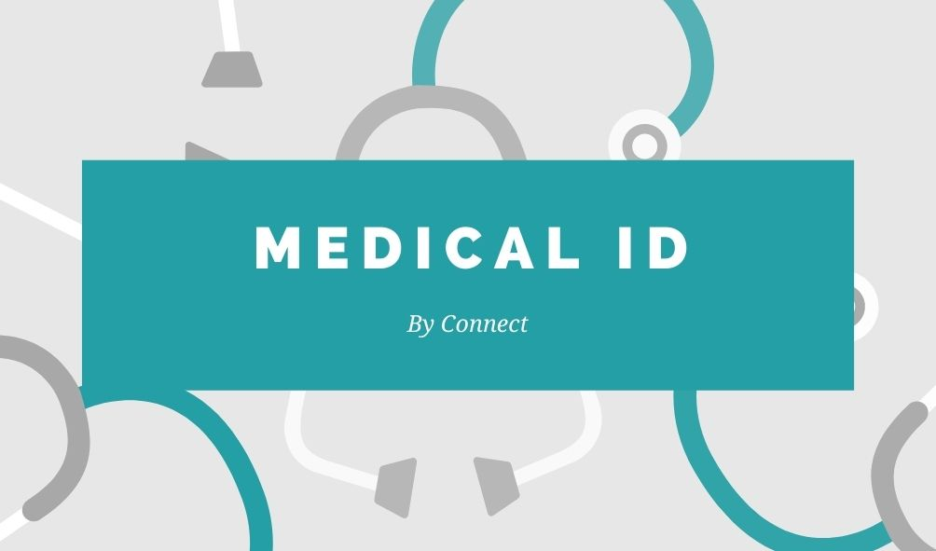
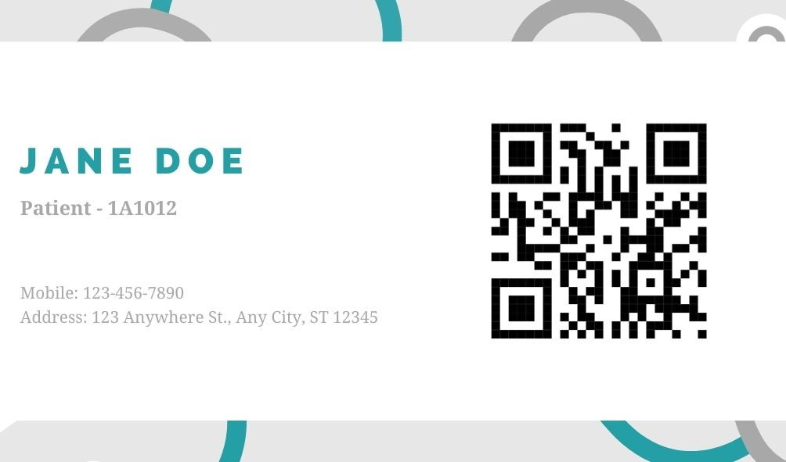
MEDICAL CARD
Using Card to track Patient's data.
Medical Card is a very effective way to directly scan the QR code on the card and access the patient’s medical history during emergency.

Slide 6
ROLES
Doctor
Pathalogy
Patient
Can access patient’s past history
Adds Lab Results of a patient.
Can easily track his/her own Health

Slide 7
USER FLOW OF DOCTOR
Patients Previous Medical History with Interactive Graphs
Can check his Next Appointment Date
Track Patient
Next Appointment
Step 1
Step 2
Step 3
Step 4
Patient Number/Patient Card
Appointment Details
Enters the Patient number or scans the QR code on the card
Add the outcome of the appointment

Slide 8
USER FLOW OF PATHALOGY
Enters the Patient number or scans the QR code on the card
Patient Number/Patient Card
Step 1
Step 2
Lab Results
Add the Lab Results

Slide 9
USER FLOW OF PATIENT
Enters the Patient number or scans the QR code on the card
Patient Number/Patient Card
Step 1
Step 2
Track his Health
Patient History (Appointment Outcomes and Lab Results) with Interactive Graphs

Slide 10
TECH STACK
HTML
CSS
JavaScript
BootStrap
Python/Flask
PostgreSQL

Slide 11
THANK YOU
TEAM BYTE PANACHE

